Slide 1
LT Internship Sharing
Cherry Tse

Slide 2
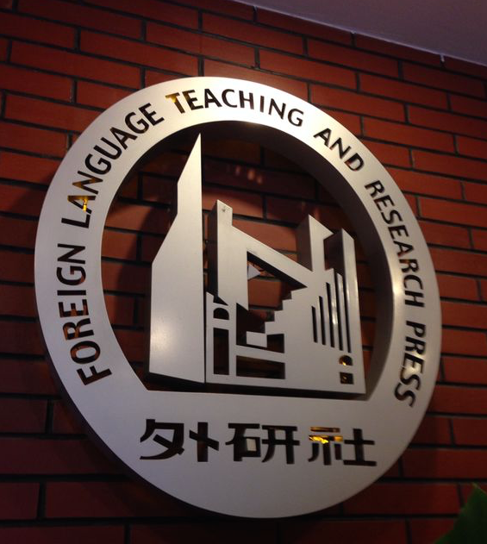
My internship
Foreign Language Teaching and Research Press (Beijing) 外研社
June - July 2014

Slide 3
My internship

Slide 4
Our working place

Slide 5
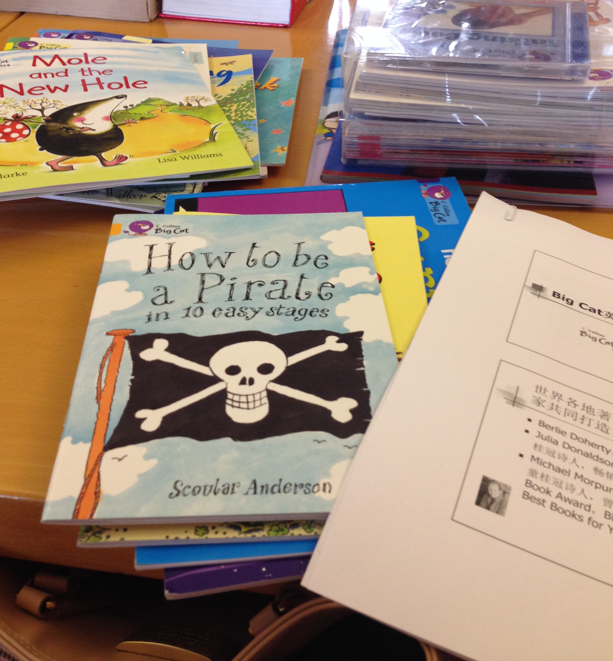
My duties
讀物工作室

Slide 6
My duties
editing the translation of Big Cat Series

Slide 7
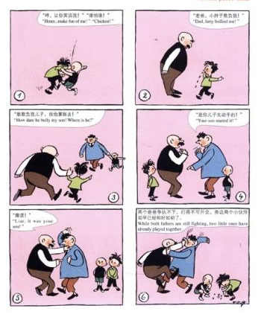
My duties
父與子 (Father & Son)
點讀筆
make use of a software link the audio and the wordings

Slide 8
My duties
draft a proposal for publishing a series of books written by Kahlil Gibran (紀伯倫)

Slide 9
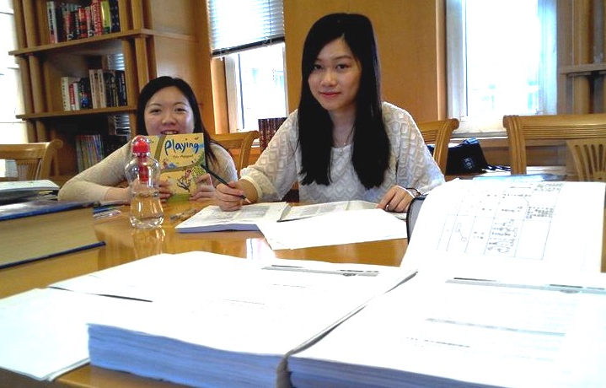
Other departments
Egnlish ??
字典部
中小學教輔部

Slide 10
In FLTRP
Work from 8am – 5pm / 8:30am – 5:30pm
Formal dressing on Mon to Thu
Casual on Fri (jeans, skirts)

Slide 11
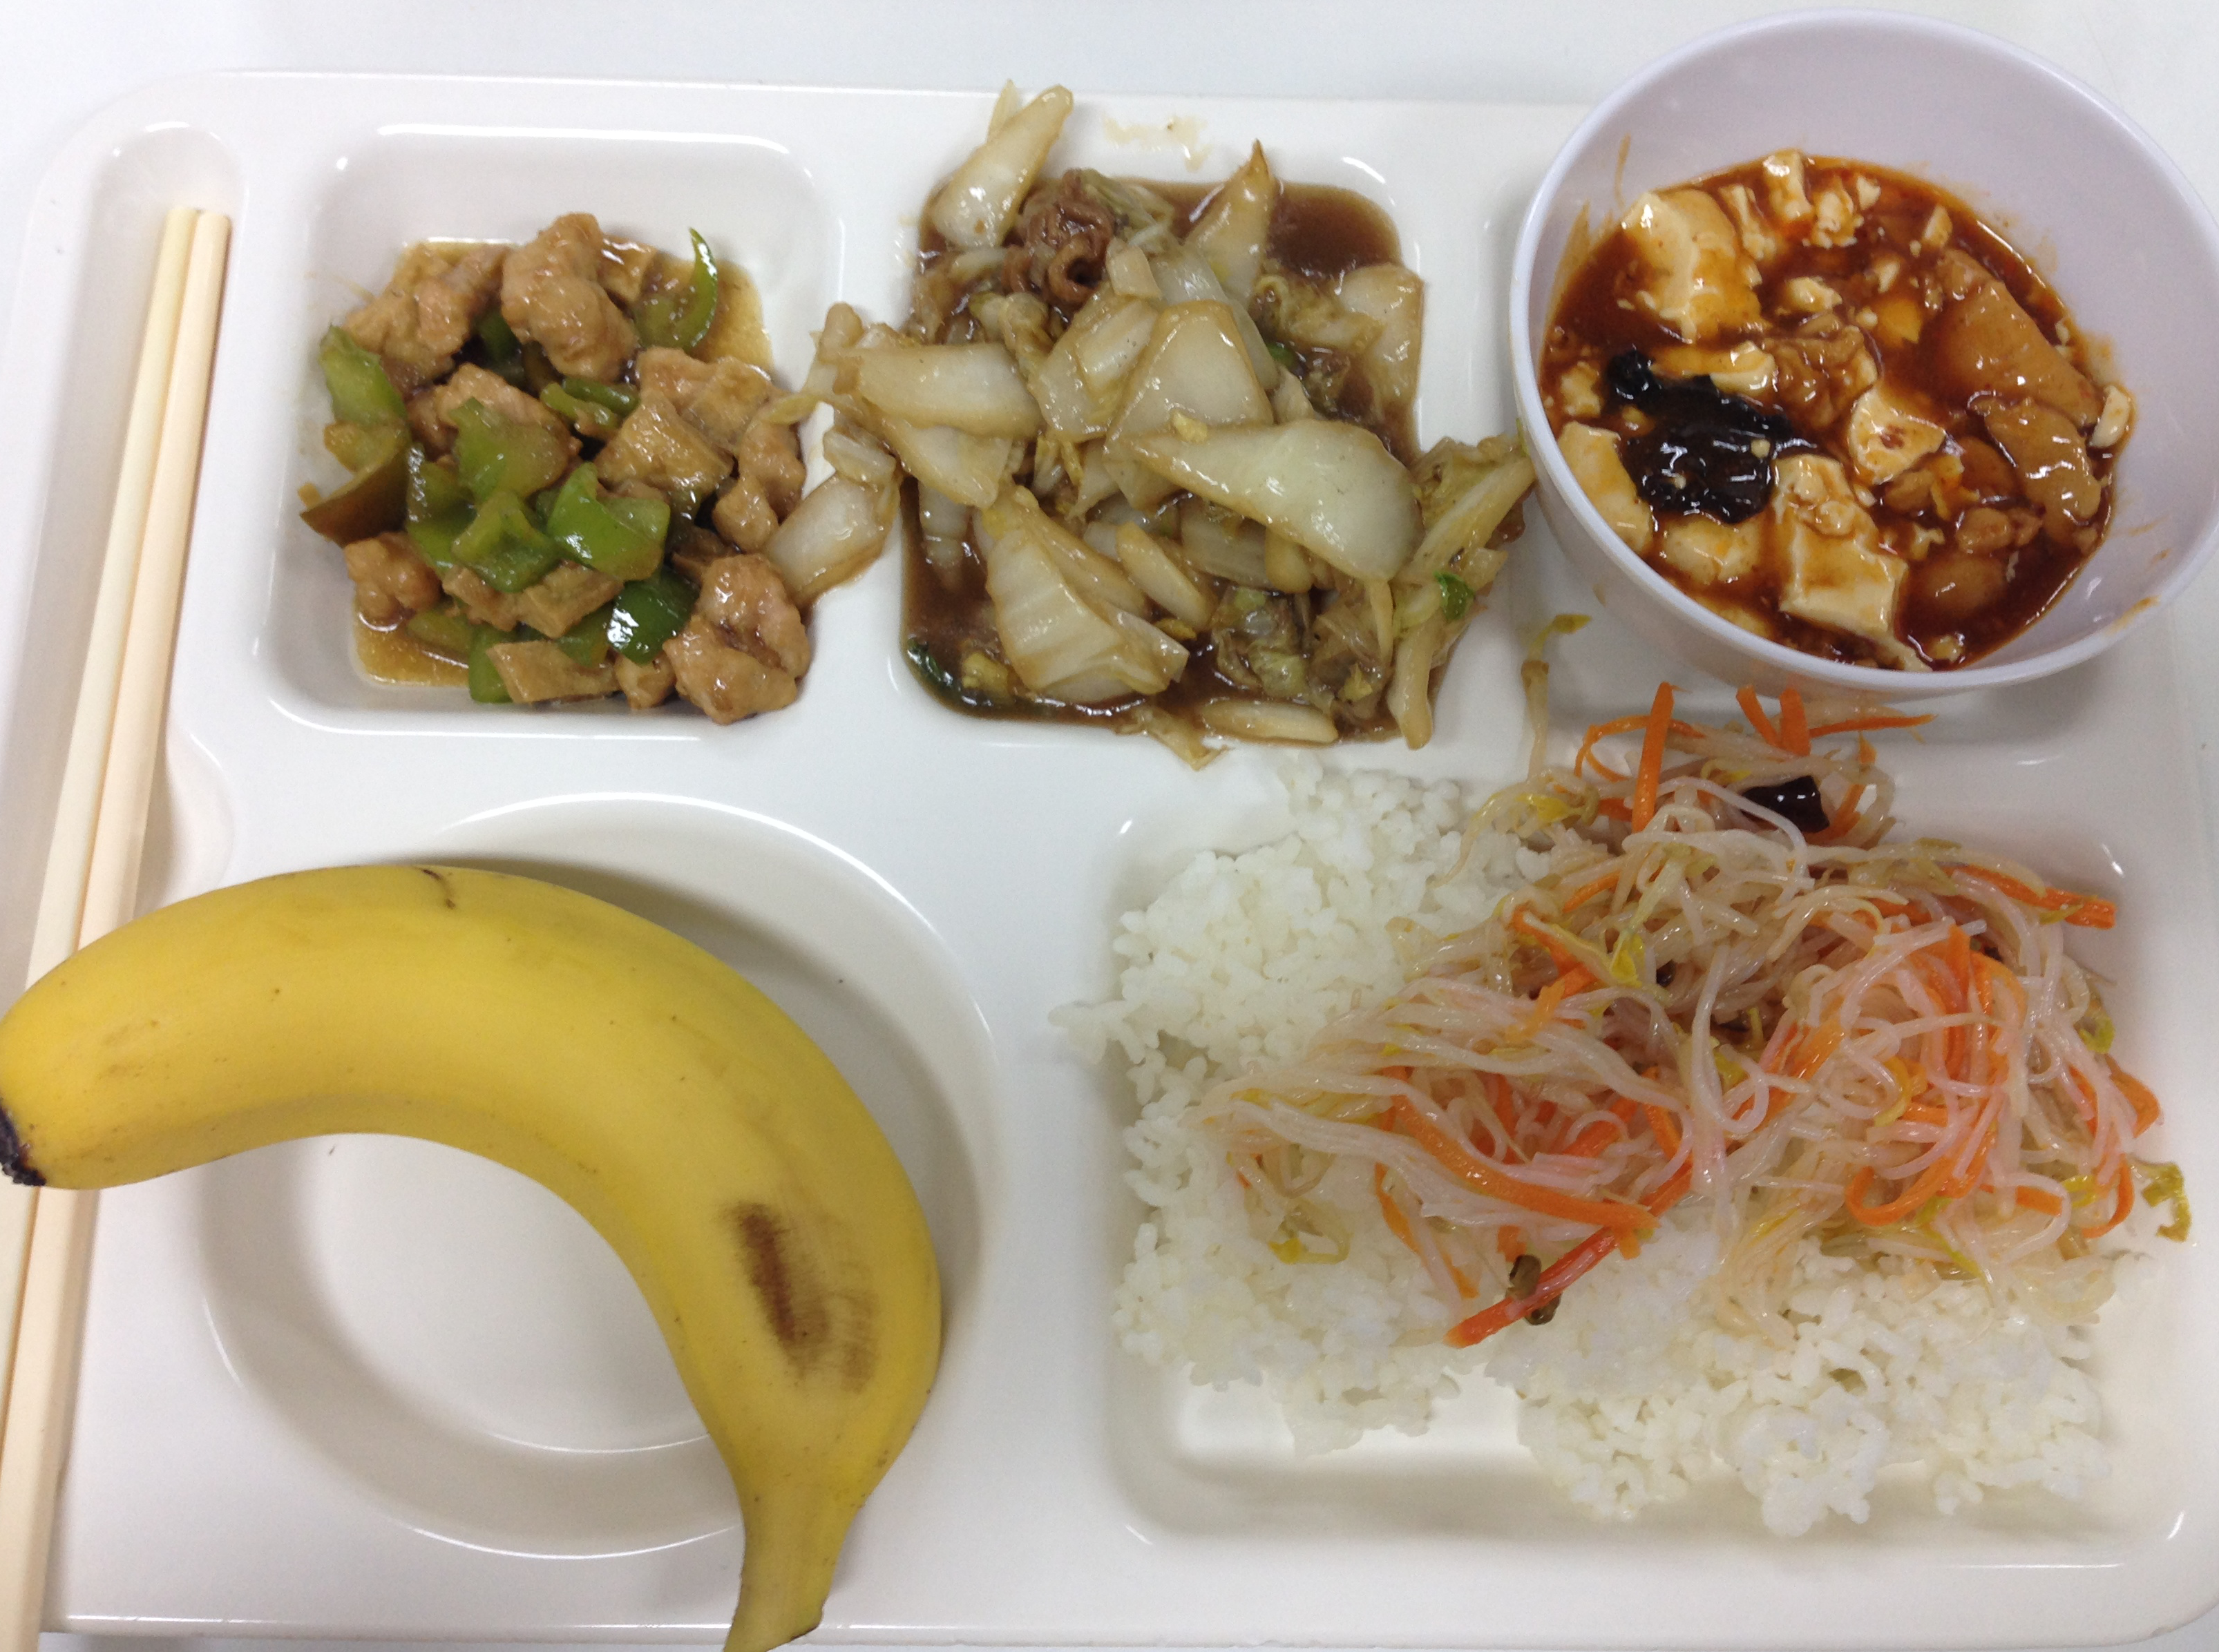
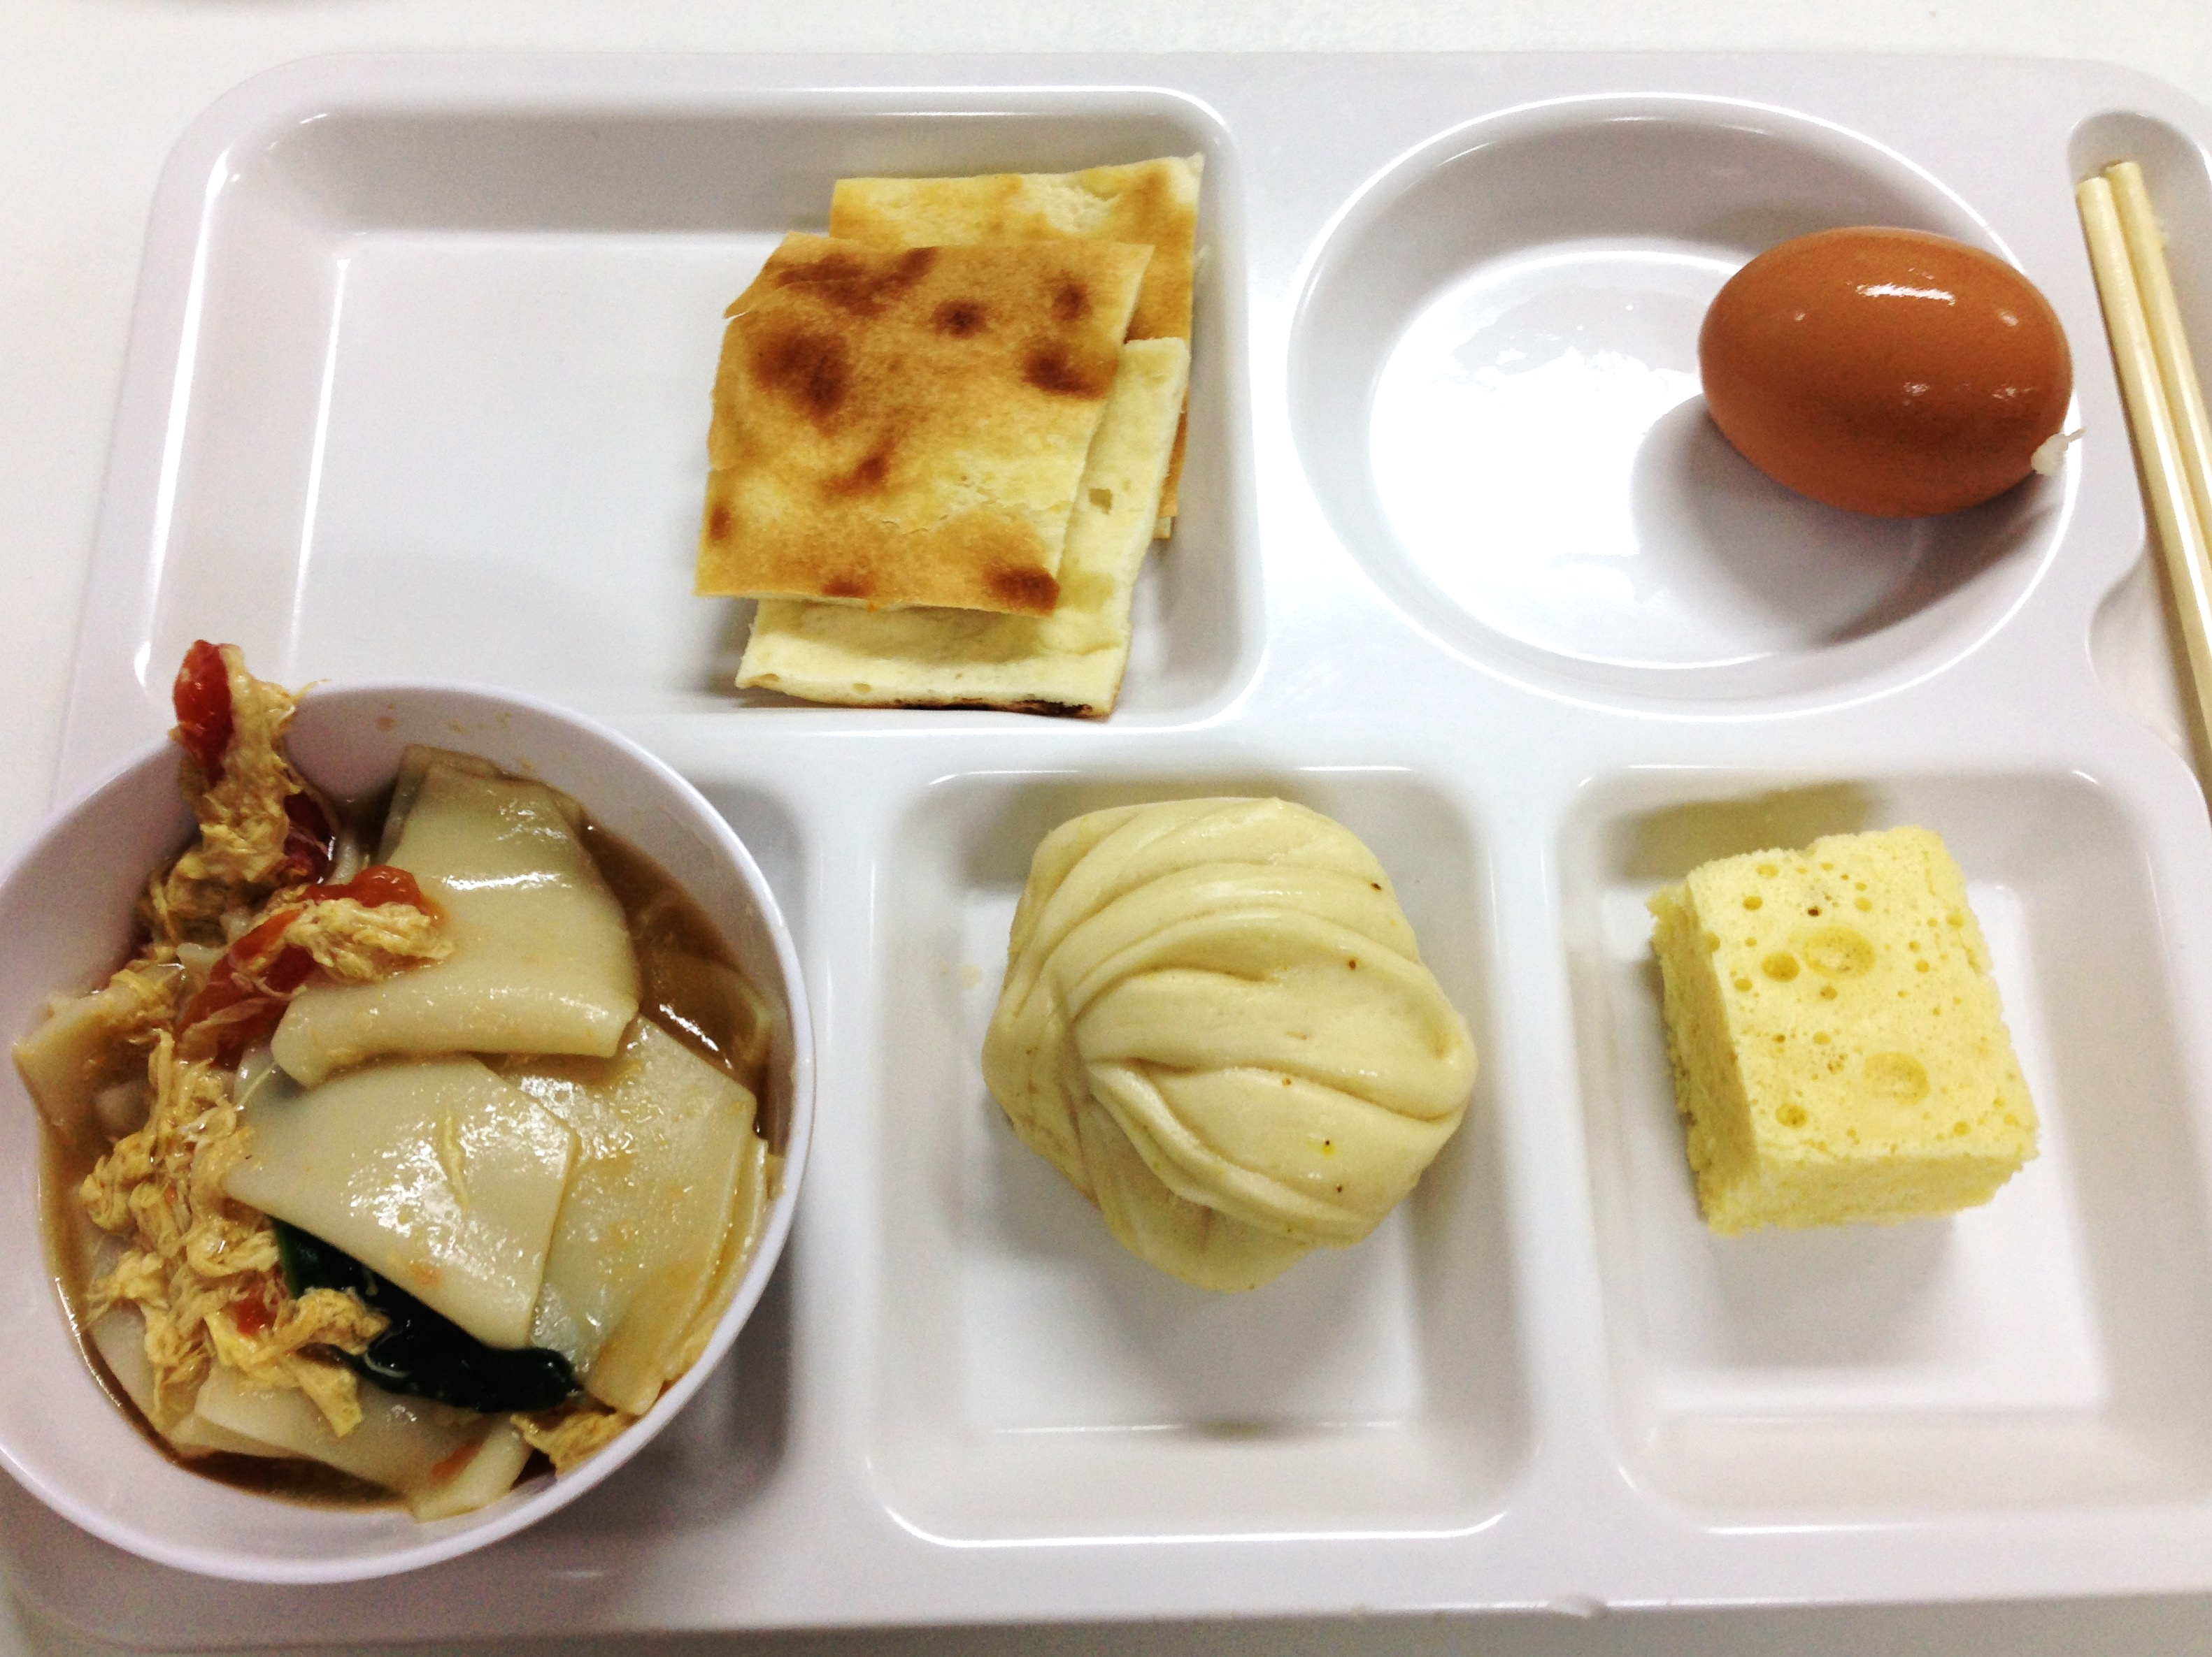
In FLTRP
Offer breakfast and lunch
Lunch : 1 hour (Mon – Thu)
Lunch : 2 hours (Fri)

Slide 12
Tips
get used to the Chinese wordings in mainland, especially during transediting
search for the location of FLTRP before booking your apartment (quite far from the railway)

Slide 13
END

