Slide 1
Sharing of my internship
Internship Company:
Etymon Communication and Brand Management Limited
Duration: 10 weeks (3rd June – 11th August 2014)

Slide 2
What is this company doing?
PR Agency
PR Events
Media Relation
Brand management
Crisis management

Slide 3
Clients

Slide 4
What did I do?
Daily work – News monitoring, Event preparation work, Translation (Press release, advertorial, Photo Caption)
PR events – Disneyland Summer program, 1600 Pandas World Tour, ParknShop City Food Drive……
Media Relation – to keep good relationship with journalists and reporters

Slide 5
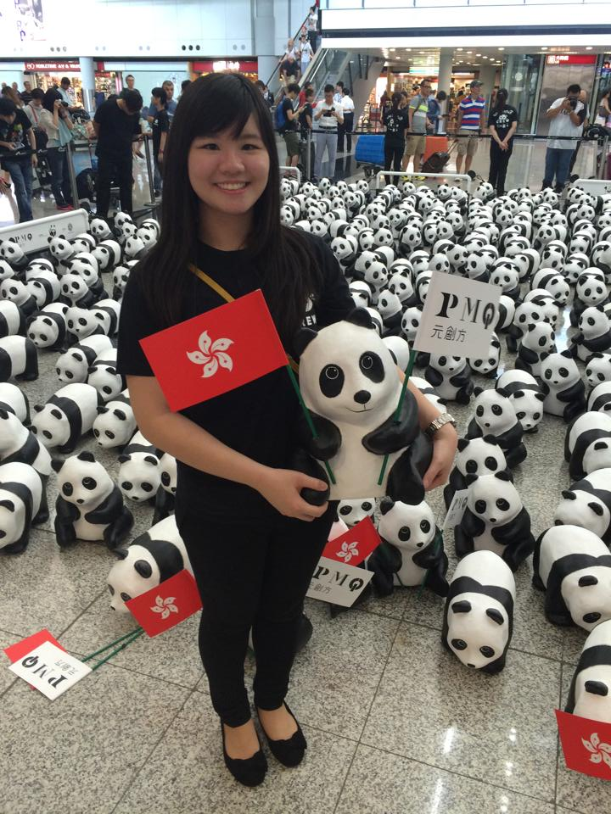
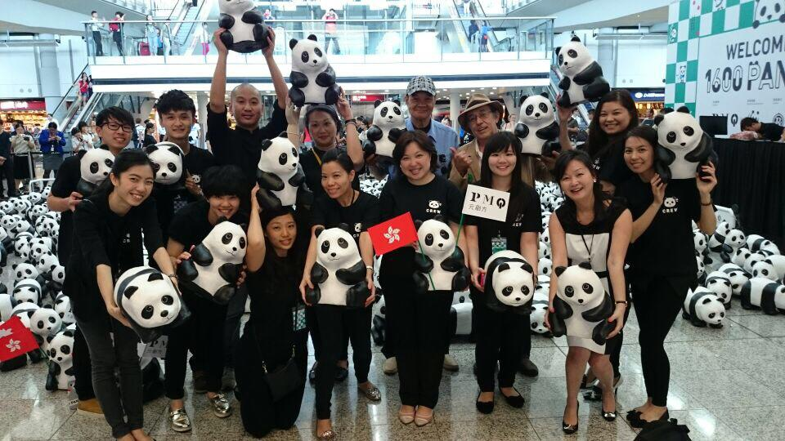
1600 Pandas World Tour

Slide 6
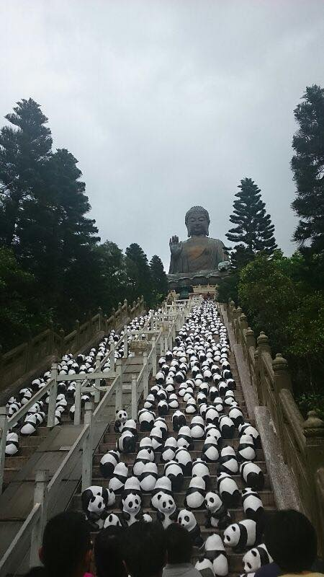
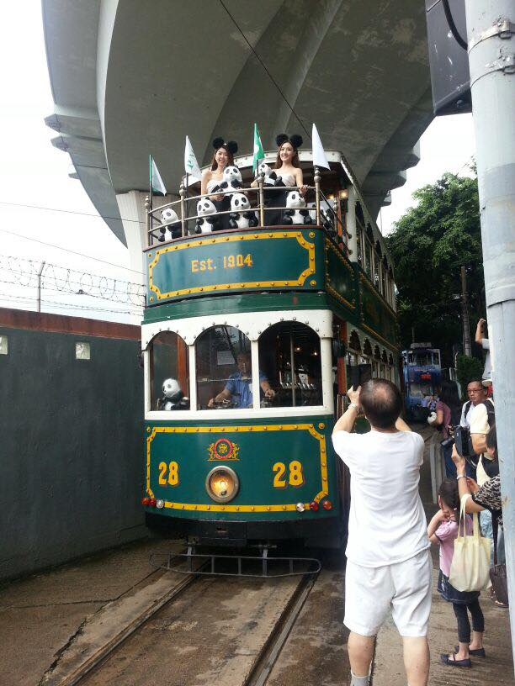

Slide 7
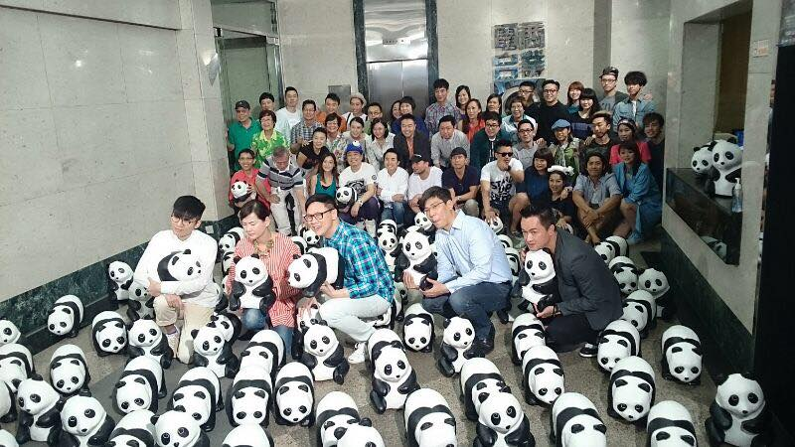
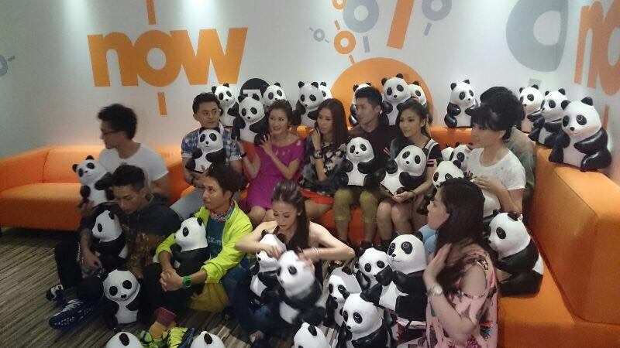
Now TV
Commercial Radio Hong Kong

Slide 8
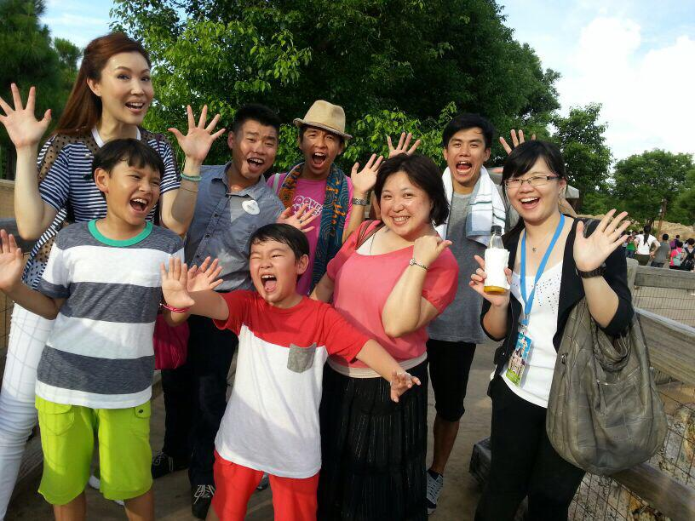
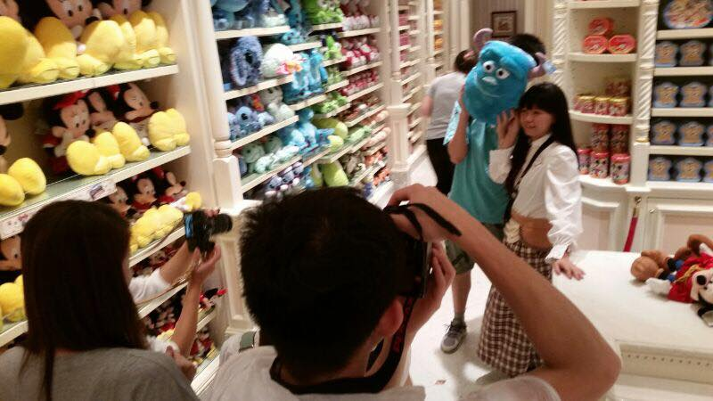
HK Disneyland

Slide 9
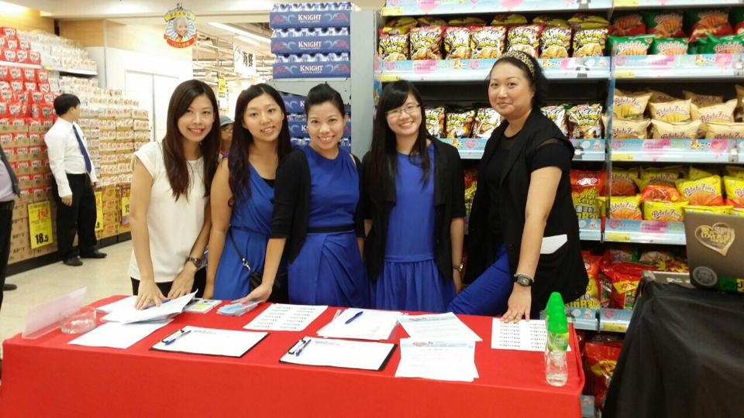
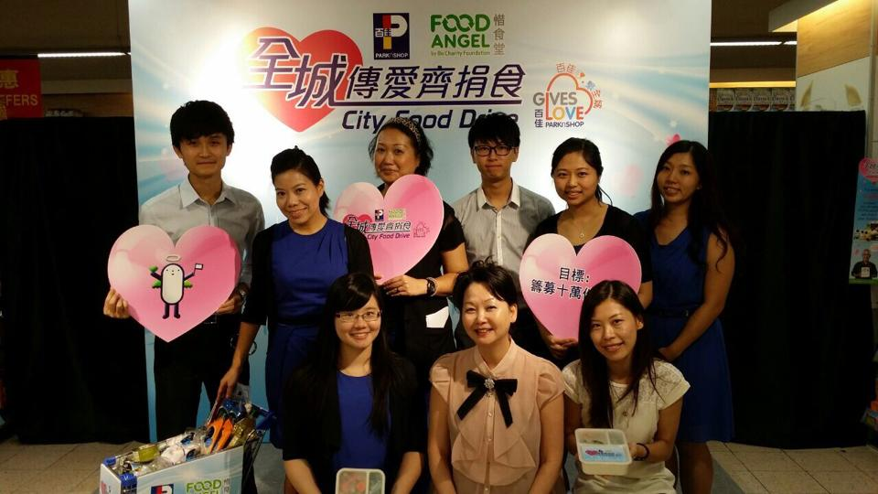

Slide 10
What have I learnt?
How PR industry looks like
Office work
Translation practice
Practical writing
……..and more

Slide 11
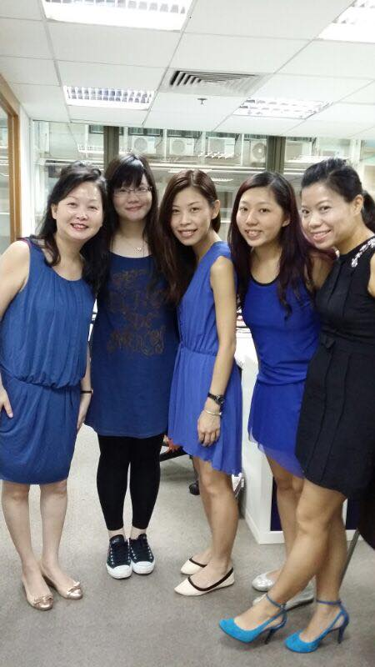
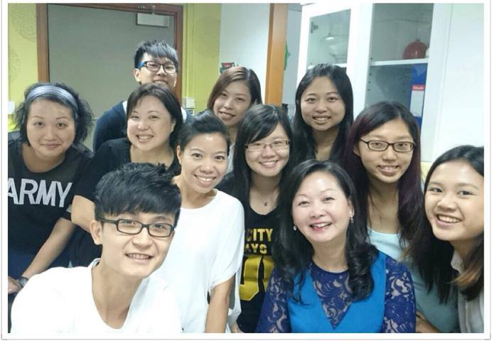

Slide 12
Who would be suitable for this job?
Good language proficiency
Outgoing
Take initiative
Not being reluctant to work till midnight

Slide 13
Do what you can do but not what you want to do.

Slide 14
Thanks!

